Slide 1


Your EMMA Jan.2023
Web development using CMS track
Intake 4
Supervised by:
Eng./Noha Salah
Presented by:
Aya Eid Fekry
Marwa Ali Mohamed
Menntuallah Nabil Salem
Rowan Ramdan Mohamed

Slide 2
01.
Background
05.
System architecture
02.
Competitors analysis
07.
Project demo
03.
Customer analysis
08.
About project
Tools and technologies
06.
04.
Proposed solution

Slide 3
Introduction

Slide 4
Background about the Project
EMMA ’ Features
EMMA Scope

Slide 5
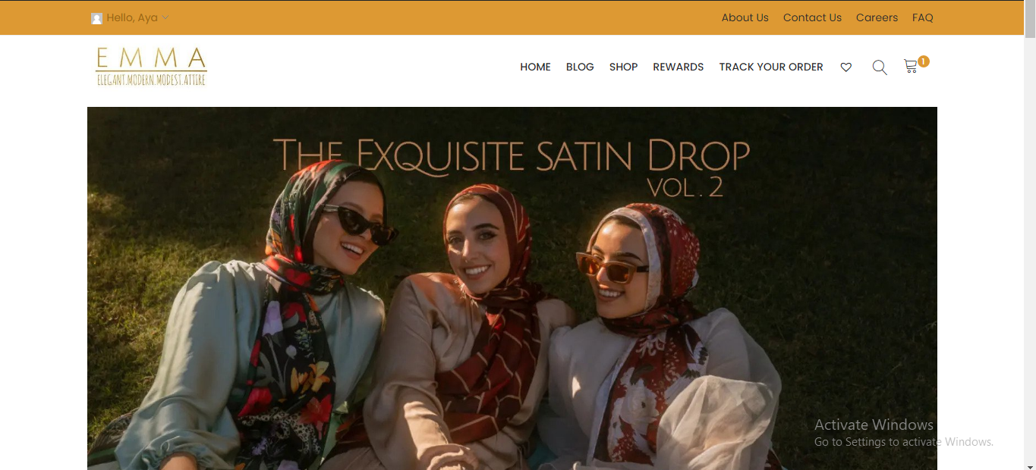
Our Website
Responsive

Slide 7
Tools and technologies

Slide 8

WordPress
42% of the web is built on WordPress.
Extensibility
Performance
Security
Reliability

Slide 9
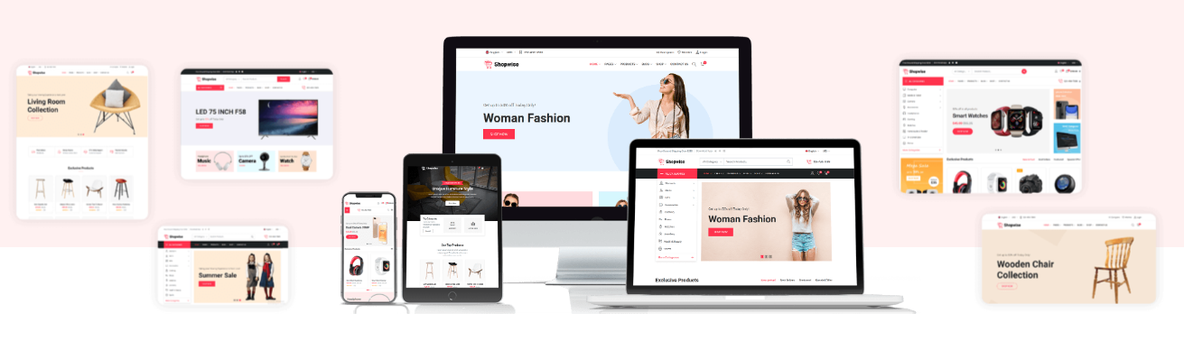
Shopewise theme

Slide 10

Plug-ins
Single banner widget via elementor

Slide 11
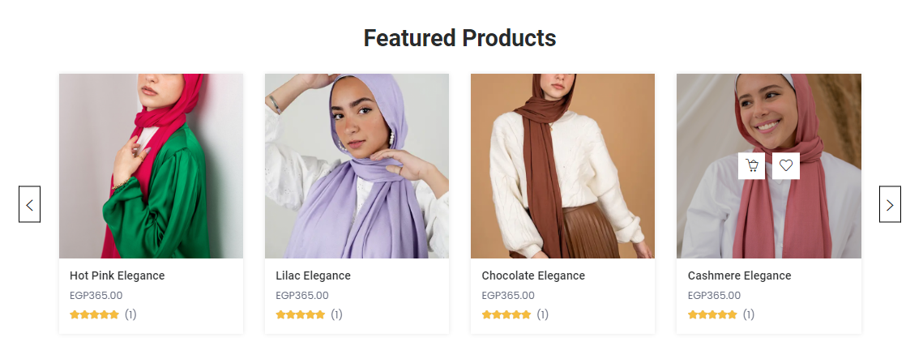
Plug-ins
Product carousel widget via elementor

Slide 12

Plug-ins
Sina posts tab widget via elementor

Slide 13

Plug-ins
Sina blog post widget via elementor

Slide 14

Plug-ins
Icon box widget via elementor

Slide 15
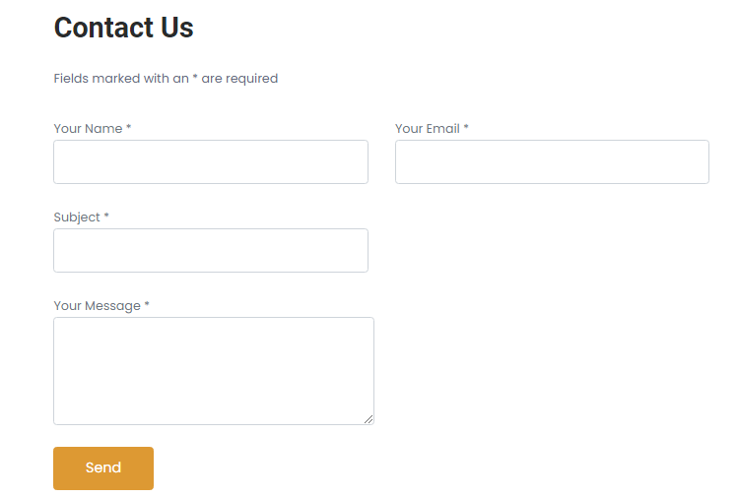
Plug-ins
Contact form 7

Slide 16
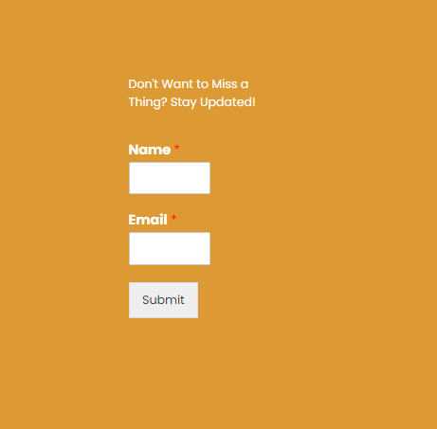
Plug-ins
Wp forms

Slide 17
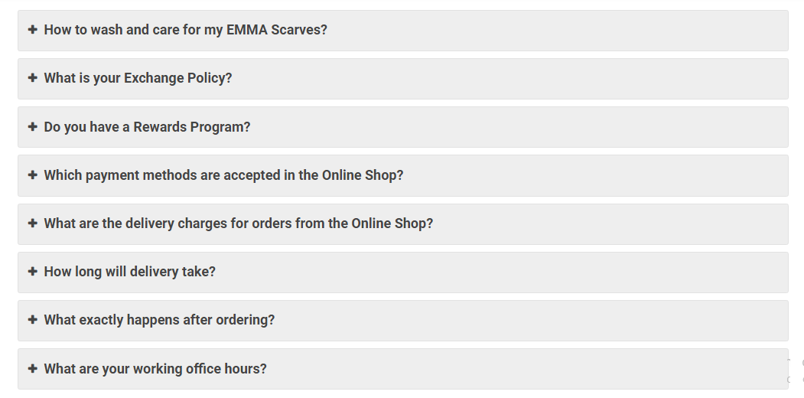
Plug-ins
Easy accorion

Slide 18
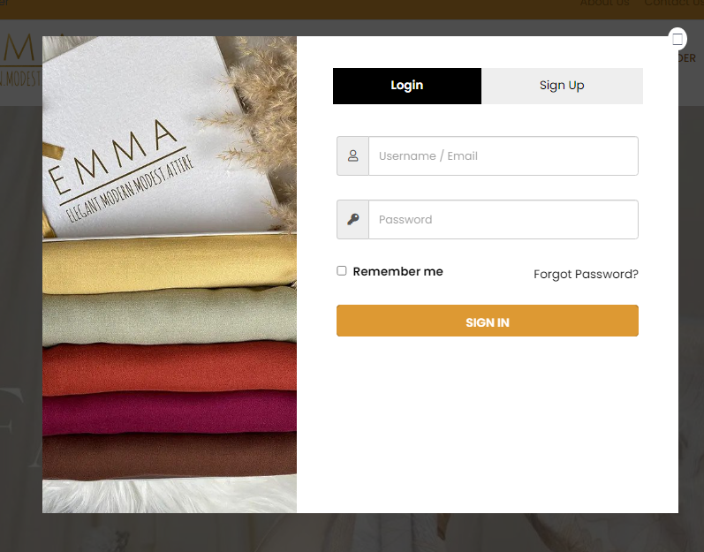
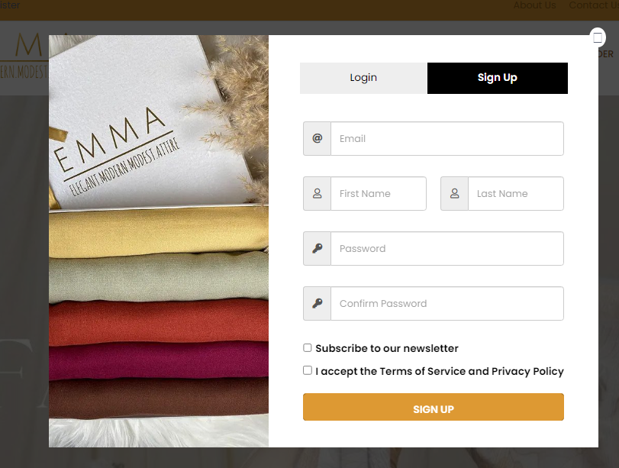
Plug-ins
Login/signup popup

Slide 19

Plug-ins
Sina content slider

Slide 20
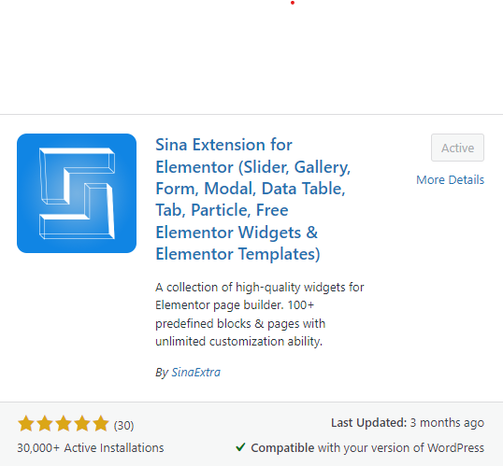
Plug-ins
Sina extension for elementor

Slide 21
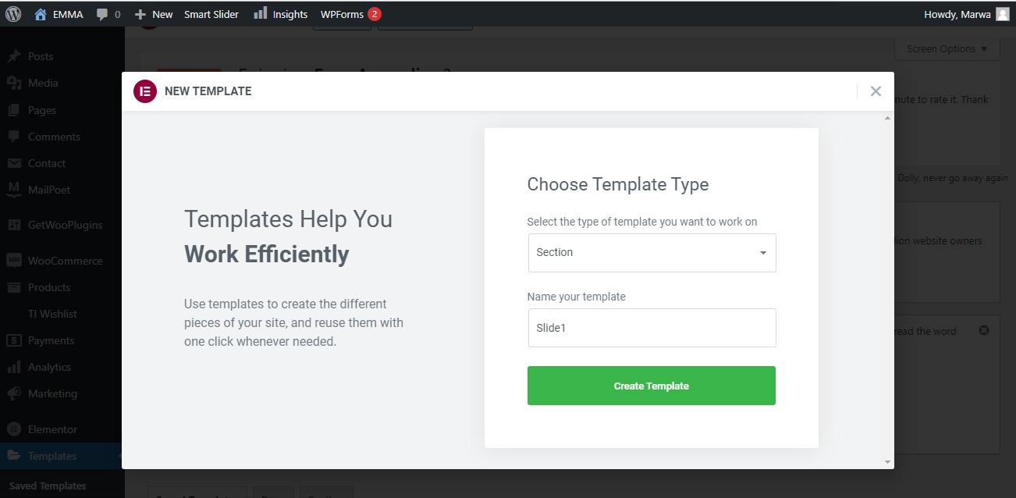
Plug-ins
Create a template

Slide 22
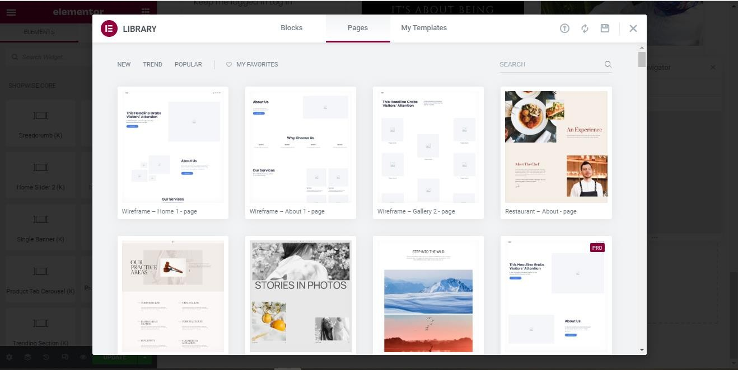
Plug-ins
Templates library

Slide 23
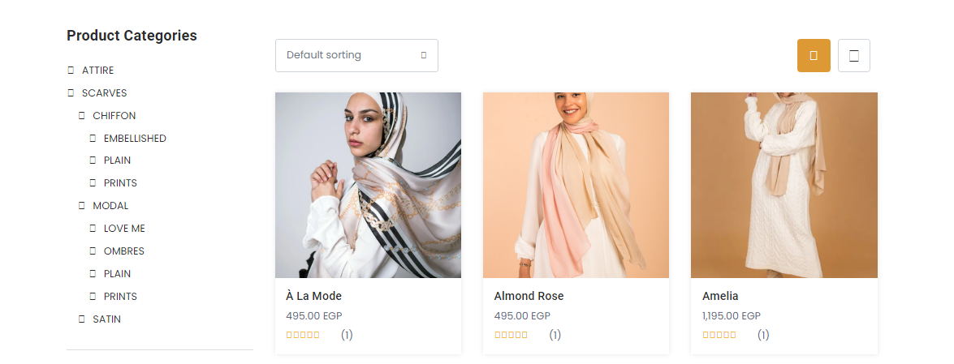
Plug-ins
Woocommerce

Slide 24
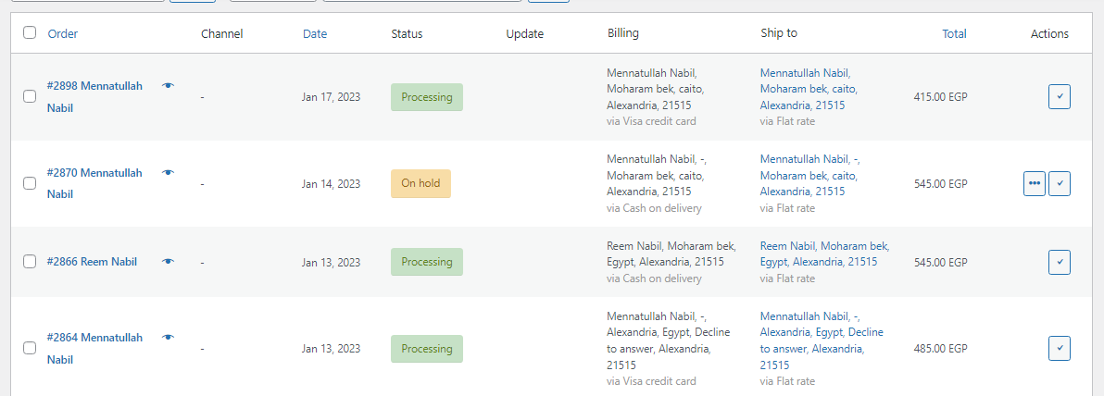
Plug-ins
Woocommerce orders

Slide 25
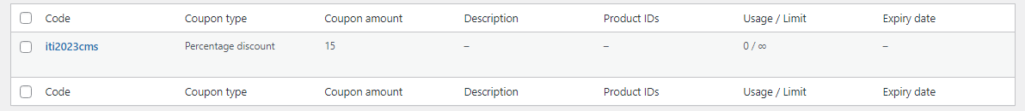
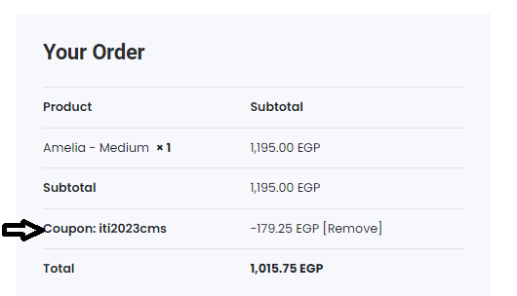
Plug-ins
Woocommerce coupons

Slide 26
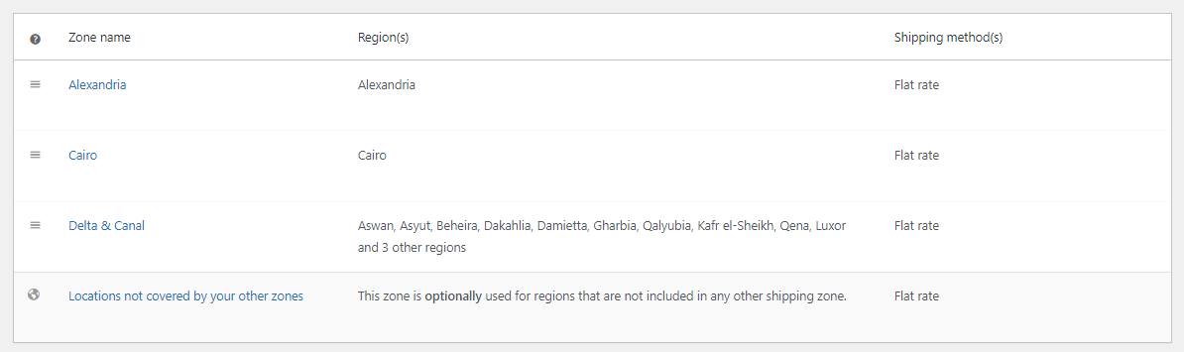
Plug-ins
Woocommerce shipping

Slide 27
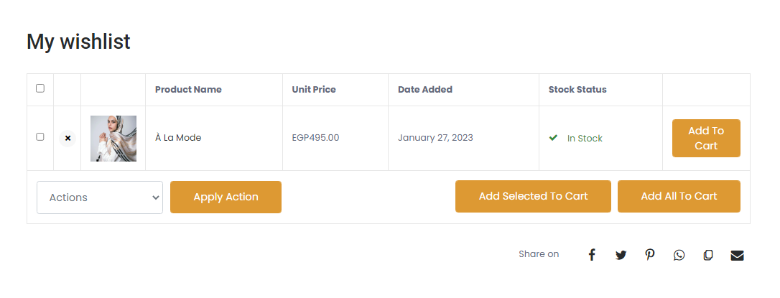
Plug-ins
Wishlist

Slide 28
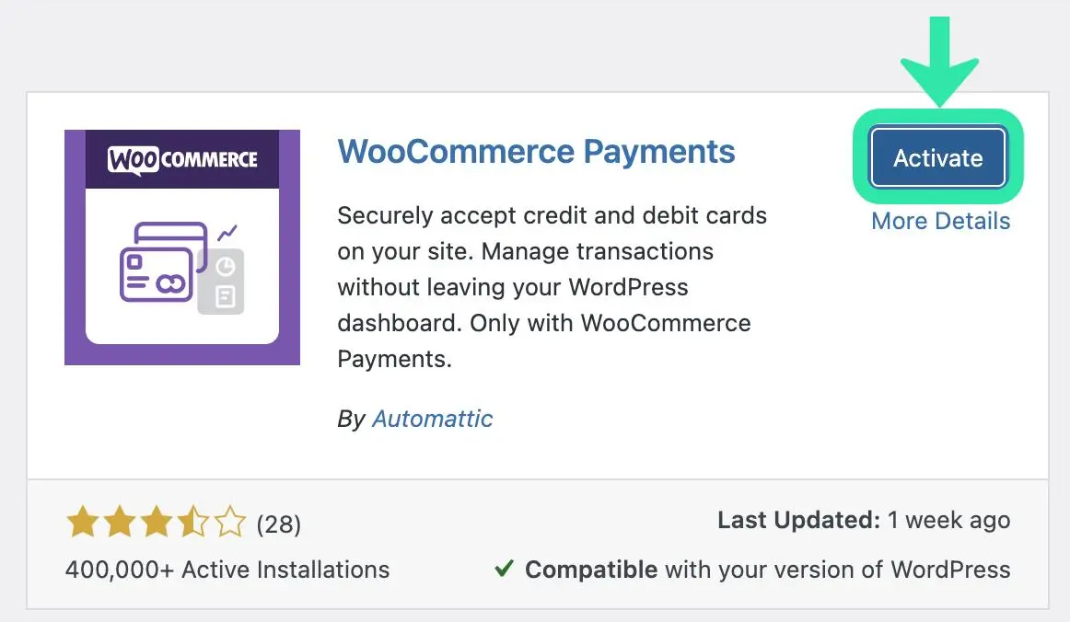
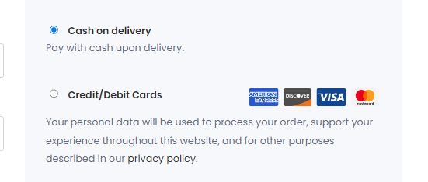
Plug-ins
Woocommerce payment

Slide 29
System architecture

Slide 30
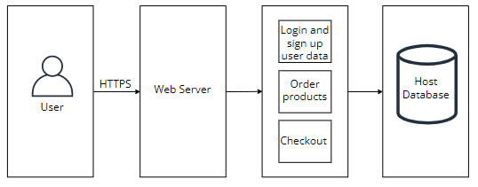

Slide 31
Project demo

Slide 32
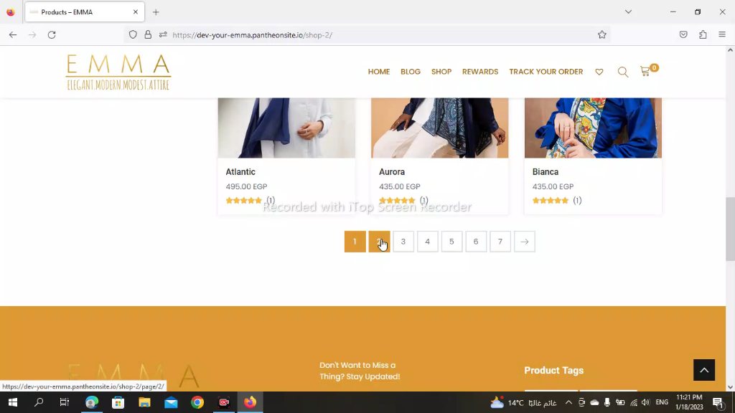

Slide 33
Customer testing phase

Slide 34
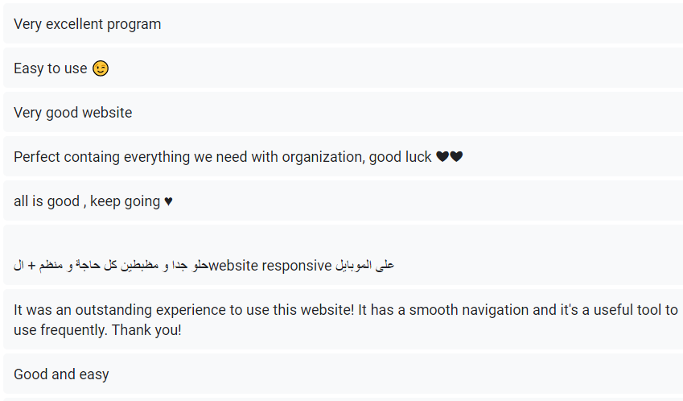
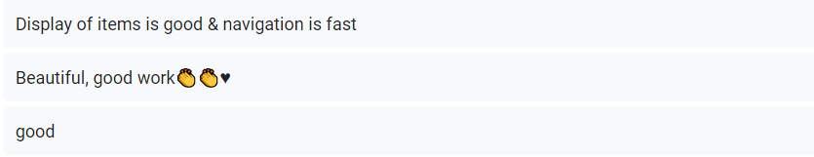
Customer feedbacks

Slide 35
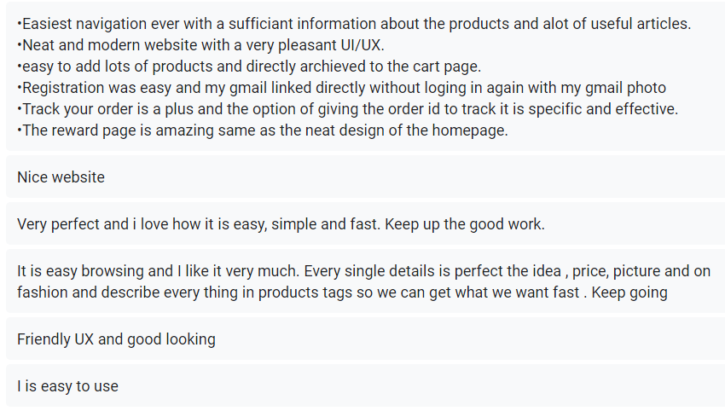
Customer feedbacks

Slide 36
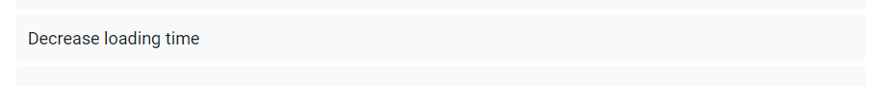
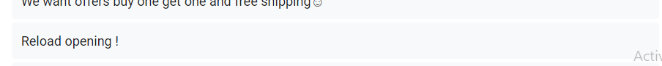
Recommenations for improvement

Slide 37

Our improvements
Host problem.
http://your-emma.infinityfreeapp.com/

Slide 38





Storyset
Create your Story with our illustrated concepts. Choose the style you like the most, edit its colors, pick the background and layers you want to show and bring them to life with the animator panel! It will boost your presentation. Check out How it Works.
Pana
Amico
Bro
Rafiki
Cuate

Slide 39
Thanks!

